Slide 1
Queue & Semaphore
The non-boring way (the Melara way)

Slide 2
What is a Queue?
An event queue is a data structure that manages and processes asynchronous events in the order they occur, enabling non-blocking handling of user actions or system notifications in software applications. It ensures events are sequentially dequeued and processed by associated event handlers.

Slide 3
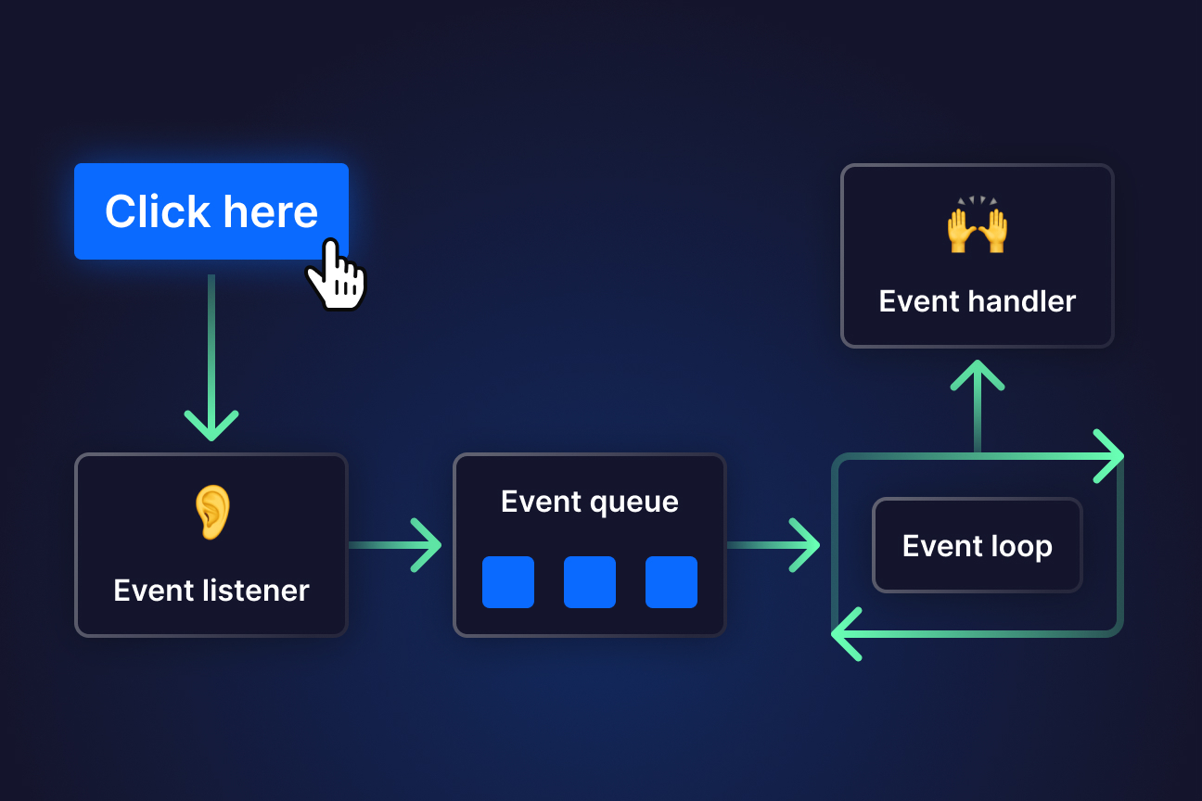

Slide 5
What is a semaphore?
A semaphore is a synchronization mechanism in programming that controls access to a shared resource, limiting the number of concurrent threads or processes and preventing race conditions
isProcessing property serves a similar purpose by indicating whether the queue is currently being processed. It prevents concurrent processing of events, acting as a synchronization mechanism to ensure sequential execution without the need for traditional semaphore increment and decrement operations.
We are using 1 permit per time for the events

Slide 6
Max permits of 3
Is this enforced by law?

